Slide 1

Remember to do the things you love with the people you love.

Slide 2
Abstract
Problem statement:
Many people have busy schedules and as a result, find themselves losing track of things that they need to do. The FreeGap App provides a solution to keeping track of events and obligations that a person may have, allowing them to virtually access their list of activities for the day.
Objectives - This application shall provide a quick and efficient way to compare gap periods. - This application must save users schedules. - This application shall allow users to modify their schedules.

Slide 3
What is FreeGap?
Current System
This application shall provide a quick and efficient way for users to set their schedules (adding, removing, editing events).
The FreeGap App allows users to access their schedule on any device or location, provided they have access to an internet connection.
Legacy System
Previous systems are calendars and/or schedulers.
These calendars allow users to modify their schedules, such as adding and deleting events.
Events in schedules can be modified.

Slide 4
Requirements Covered
Functional
Create an account.
Sign in and out of their account, given that it has been made.
Add and edit events to the user’s schedule.
Remove an event from the user’s schedule if it exists.
Store events in the user’s schedule.
Non-Functional
The application must be able to run on Mac OS.
The application’s error messages will be displayed in English.

Slide 5
Architectural Design
Class, sequence, database

Slide 6
UML Diagram

Slide 7
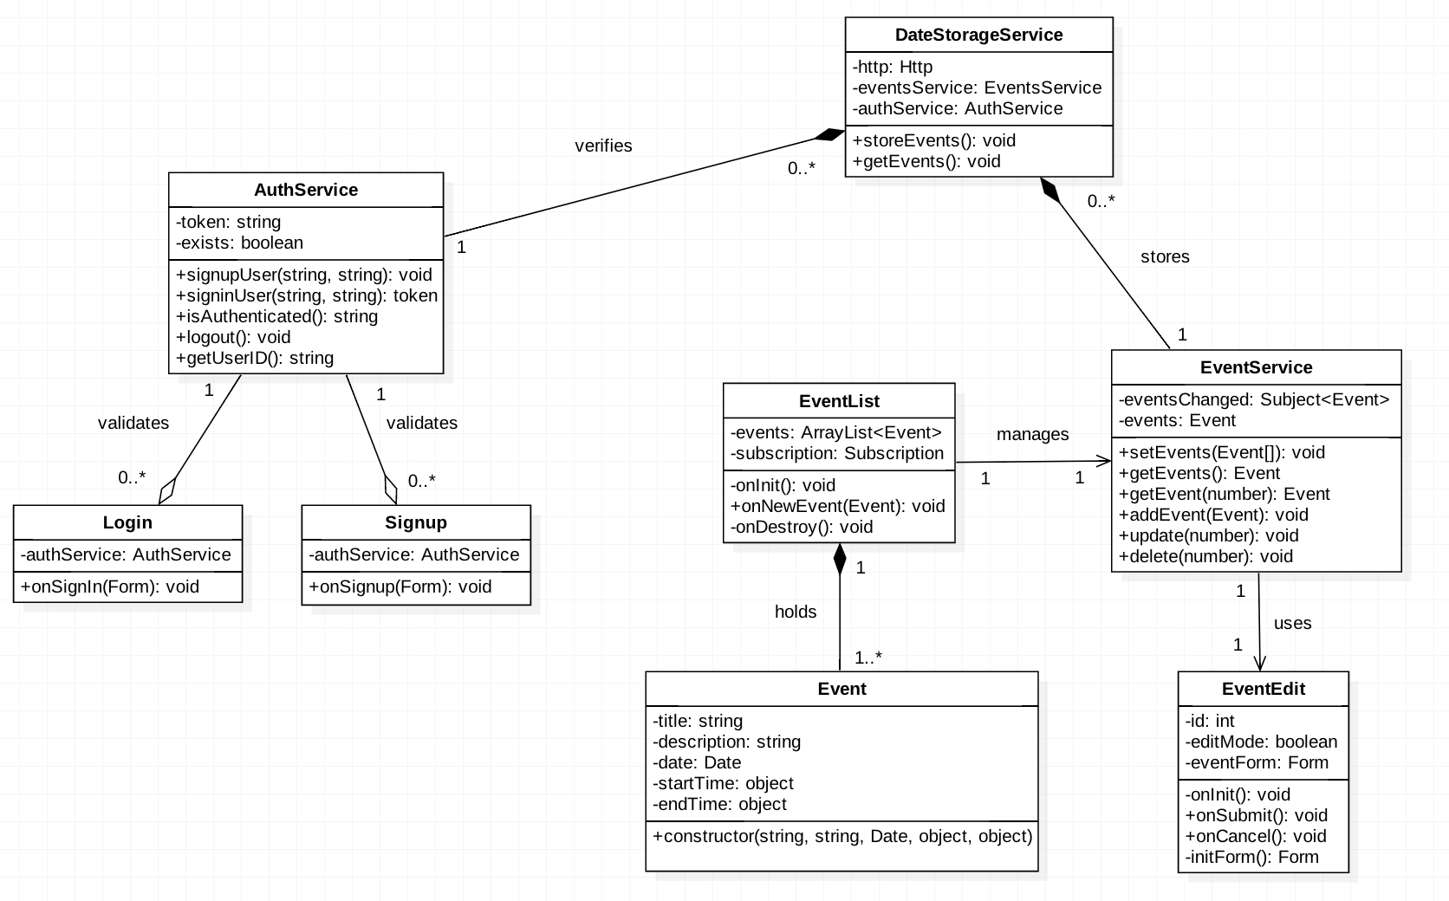
Storage
Authentication
Model
Controller
Login
Signup
Event
Edit

Slide 8
Sequence Diagrams

Slide 9
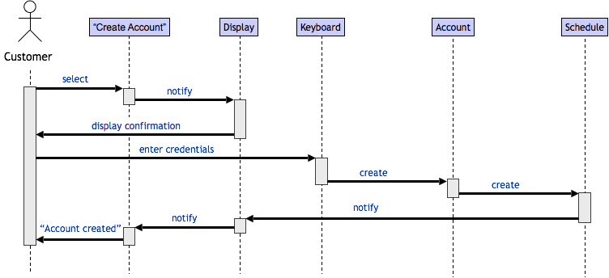
Sequence Diagram: Create Account

Slide 10
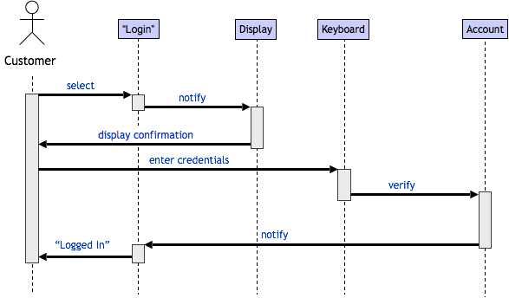
Sequence Diagram: Log In

Slide 11
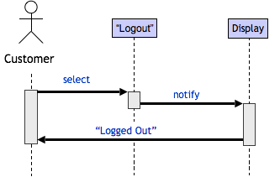
Sequence Diagram: Log Out

Slide 12
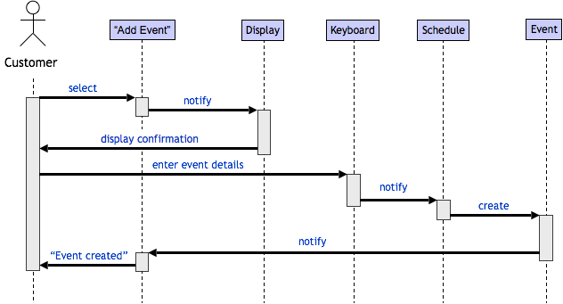
Sequence Diagram: Add Event to Schedule

Slide 13
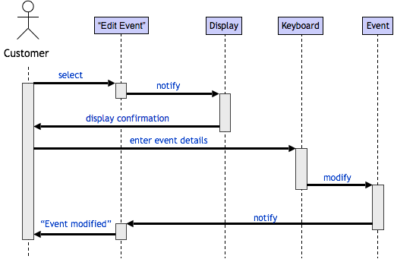
Sequence Diagram: Edit Event

Slide 14
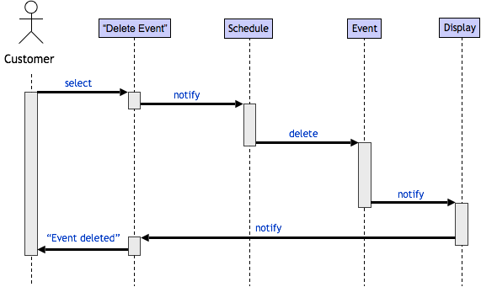
Sequence Diagram: Delete Event from Schedule

Slide 15
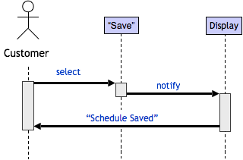
Sequence Diagram: Store Event

Slide 16
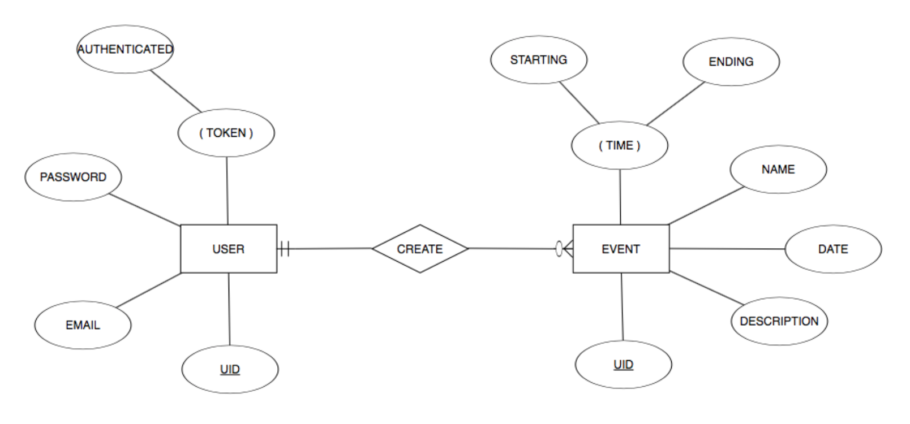
ER Diagram

Slide 17
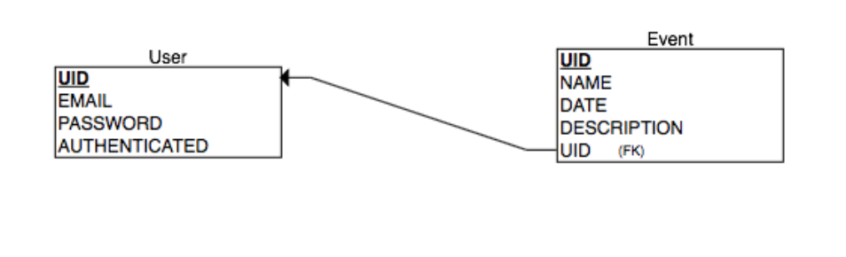
Relational Diagram

Slide 18
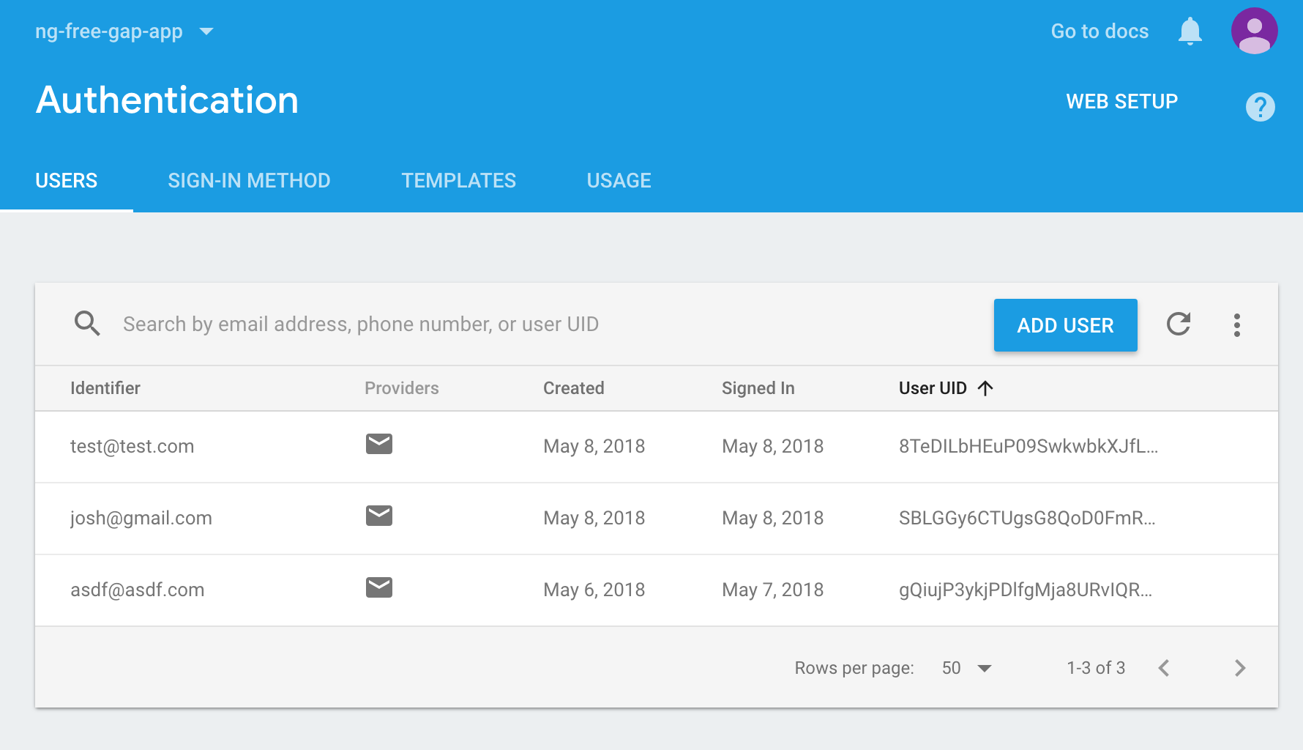
Authentication Database

Slide 19
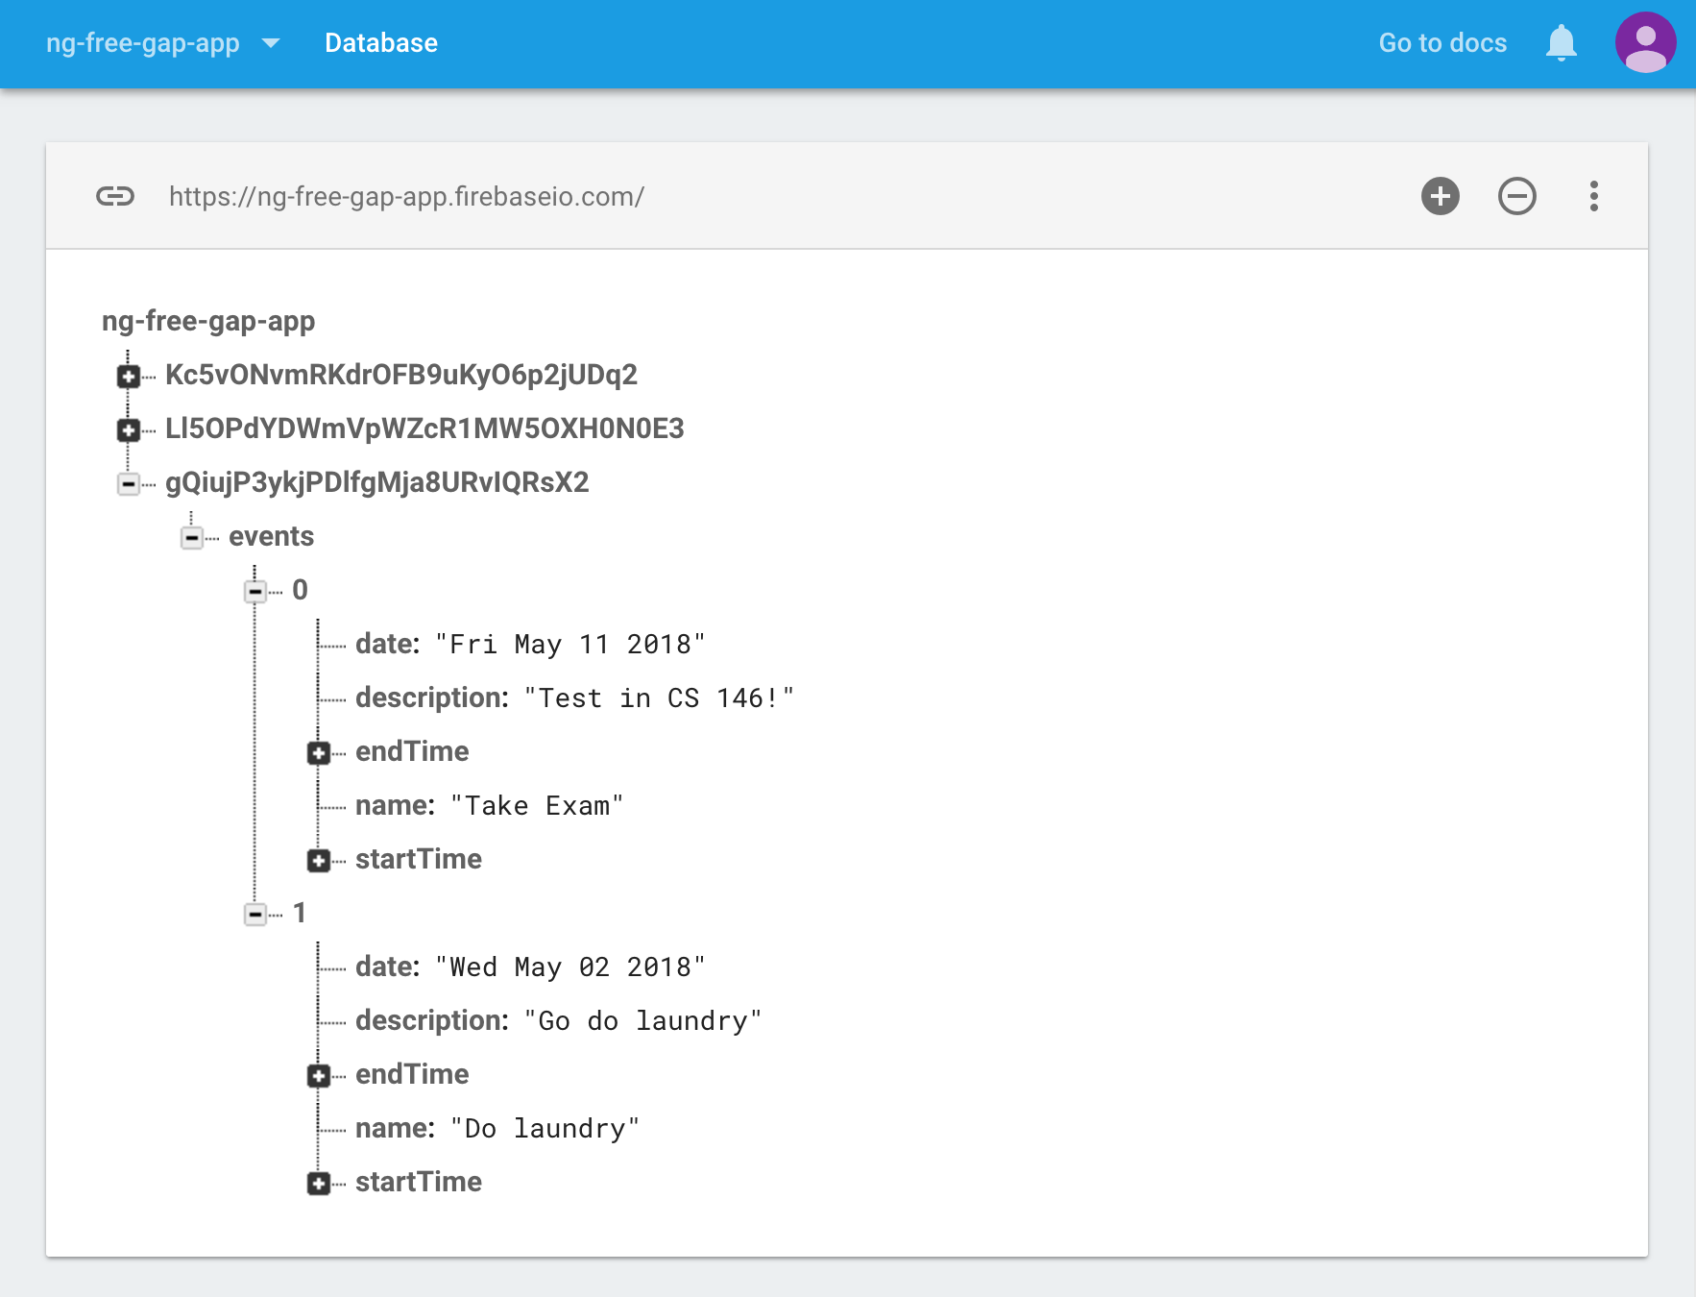
Event Storage Database

Slide 20
Testing: Create Account
Test Scenario | Input | Expected Output | Actual Output | Test Case
New Account With New Email | qwerty@heel.com hellog | Account is created | Account is created | Pass
New Account with Existing Email | asdf@asdf.com richard | Error: cannot be created | Error: cannot be created | Pass
New Account With Misspelled Password | rofl@yahoo.com Www1 (Wmw1) | Error: cannot be created | Error: cannot be created | Pass

Slide 21
Testing: Login and Logout
Test Scenario | Input | Expected Output | Actual Output | Test Case
Sign Into Existing Account | asdf@asdf.com richard | Signed in | Signed in | Pass
Sign Into Non-existing Account | rofl@yahoo.com Mimi123 | Error: account does not exist | Error: account does not exist | Pass
Sign Out of Account | asdf@asdf.com | Signed out | Signed out | Pass

Slide 22
Testing: Adding Event
Test Scenario | Input | Expected Output | Actual Output | Test Case
Add to Empty Schedule | Click add | Event is added | Event is added | Pass
Add to Full Schedule | Click add | Error: cannot be added | Event is added | Fail
Add with conflicted time | Click add | Error: cannot be added | Event is added | Fail

Slide 23
Testing: Removing Event
Test Scenario | Input | Expected Output | Actual Output | Test Case
Remove From Full Schedule | Click event, click delete | Event is removed | Event is removed | Pass
Remove From Empty Schedule | Click event, click delete | Error: cannot be removed | Event is removed | Fail
Remove and Replace with New Event | Click event, click delete, click add. | Event is removed, Event is added | Event is removed, Event is added | Pass

Slide 24
Testing: Edit Events
Test Scenario | Input | Expected Output | Actual Output | Test Case
Edit Time | Time changed | Event is edited | Event is edited | Pass
Edit Name | Name changed | Event is edited | Event is edited | Pass
Edit Date | Date changed | Event is edited | Error: cannot edit | Fail

Slide 25
Using FreeGap
Code will be demonstrated now…

